Slide 1
Internet Datagrams
The Millennial Telegraph

Slide 2

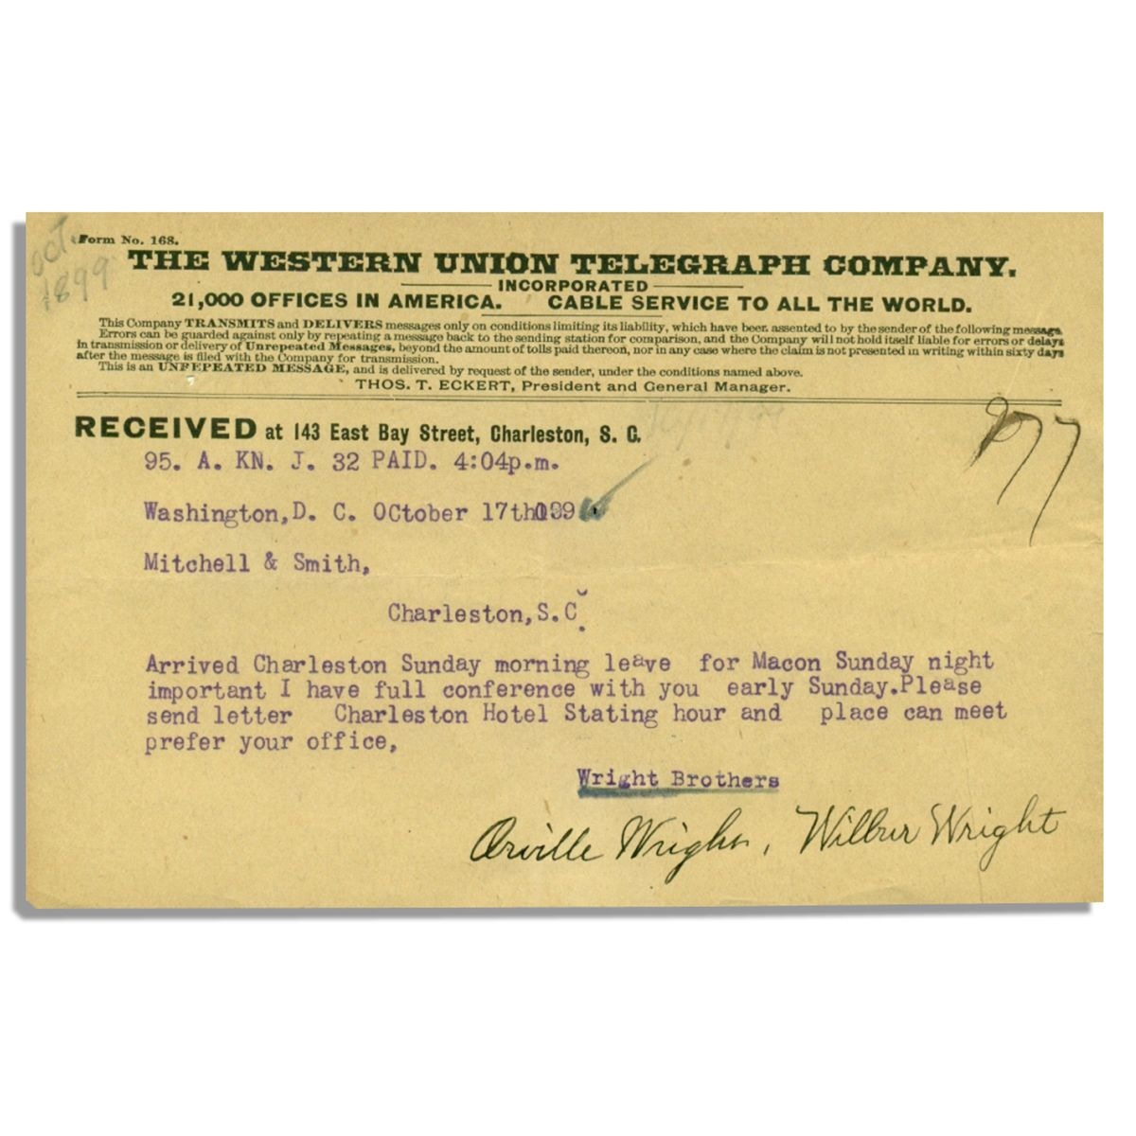

The Telegram
Self-contained
Conveys data
Independent
Ignorant of its medium
Notes:
So here’s a telegram, from 1899. What’s true about it?
Well, it’s self-contained—everything we need to deliver it is right here. Network address, local address, source, message, even whether it was paid for.[CLICK]
It carries data. In fact it doesn’t matter what data it carries—the telegram gets delivered regardless.[CLICK]
It’s independent of other telegrams—maybe it refers to them, but that’s up to the writer, and just matters for content. The telegram itself gets delivered without that information.[CLICK]
And it’s ignorant of its medium. It doesn’t matter how this message gets sent. It’s not, for example, pre-translated into Morse code. It contains addressing information, but that info is opaque to the author. And there may be other data associated with it, but that all gets stripped away before delivery.

Slide 3
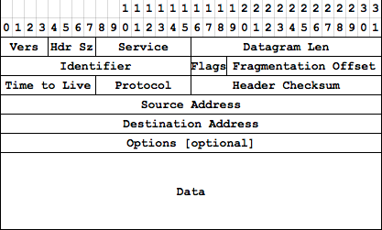
The Datagram
“A self-contained, independent entity of data carrying sufficient information to be routed from the source to the destination computer without reliance on earlier exchanges between this source and destination computer and the transporting network.”
—RFC1594
Notes:
Datagrams were modeled in part on telegrams—that’s where the name comes from—and their formal definition matches what we identified was true about telegrams.
Don’t pay attention to the diagram yet.
Datagrams are the fundamental unit of the Internet. FTD wants you to say it with flowers; well on the Internet you say it with datagrams. But datagrams are just like that telegram—they’re an abstraction. So let’s see what we’re abstracting away.

Slide 4
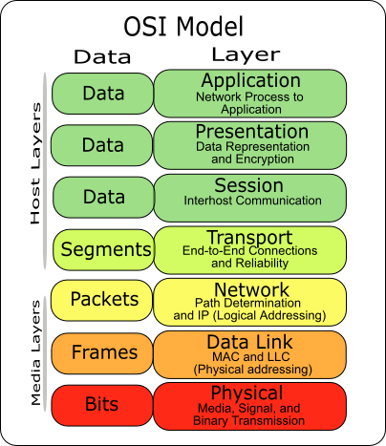
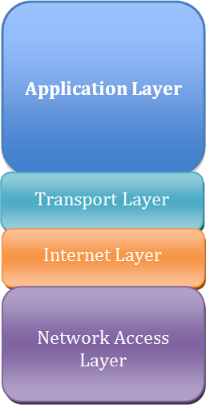
Notes:
Here’s the other thing you need to know: ALL PEOPLE SEEM TO NEED DATA PROCESSING. This mnemonic will help you remember the layers of this model, which I promise you someone will ask you about in an interview one of these days.

Slide 5
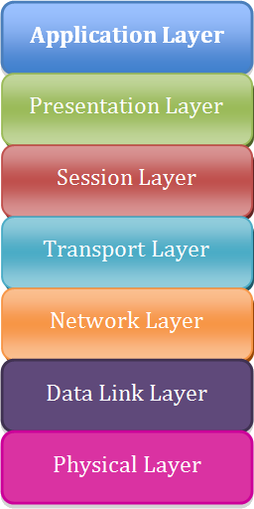
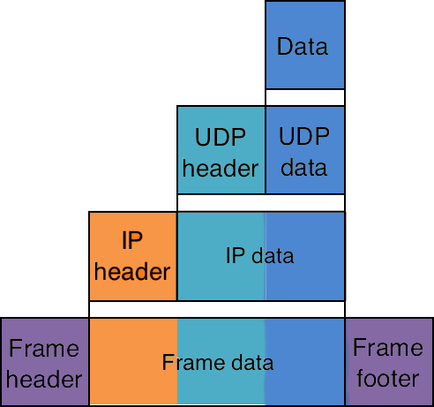
The TCP/IP Model
Notes:
So let’s see the model you should use instead. [By the way, if you want to google for more information on this, be sure to call it the TCP/IP Model. Another name for it is the Internet Model, but if you search for “internet model” you get a COMPLETELY DIFFERENT set of results.]
The Internet model has four layers, which is good because there’s only four layers of abstraction in practice. [CLICK] There’s your application, the transport layer—that’s UDP and TCP—the Internet layer, and the network itself—Ethernet.
[CLICK]
Each of these manifests itself by adding data to the datagram. So you create data, you wrap it in UDP, the operating system wraps that in IP, and the network driver wraps that in a frame. The set of software responsible for making all this happen is called a “TCP stack”, because it behaves like a stack.
Oh, and you want a mnemonic to remember this one? ALL THAT IS NECESSARY.

Slide 6
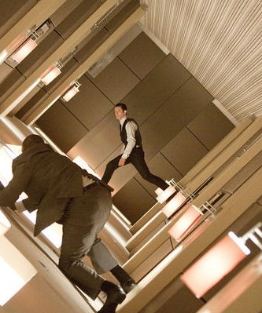
Handling Abstraction
Operate at your level
Do what’s necessary for one level down
Be aware of the other levels
Notes:
So you’ve got these packets within packets within packets, right? It can be a lot to think about. Handle it this way: [CLICK]
First, the abstraction is there for a reason—to let you get your job done. You’re primarily living at the application level; stay there as much as you can. [CLICK]
You’ll need to deal with one level down—not just understand it, but actually set things up for it. [CLICK]
The other levels, just be aware they exist. They’ll occasionally matter to you, and part of the awareness you need to cultivate is knowing when they matter. But again, the abstraction is there for a reason, and don’t lose sight of that.

Slide 7
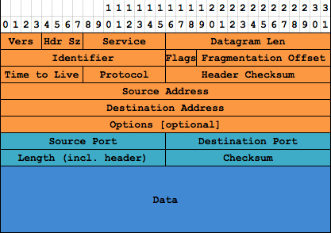
UDP
Thinnest possible layer atop Internet Protocol (IP)
“Fire and forget” services like DNS, RIP, DHCP
Streaming audio and video
Games
Notes:
TCP was actually created first. If you’ll remember, there were specific problems with ARPANET, relating to reliability and having to retransmit packets, and so solving those was the first priority in creating the Internet. TCP is a heavyweight solution that provides the maximum reliability. It was originally intended to have switches that let you turn the heavyweight features off selectively, but that fell through (too complex to design). People needed a lightweight datagram protocol, so UDP was invented as the thinnest possible layer over IP.

Slide 8

Notes:
This is what a UDP packet looks like, including its IP header info. Remember back at the TCP/IP Model slide, this is the same color coding—dark blue for our data, light blue for what UDP adds, orange for what IP adds. We’re ignoring the network layer purple stuff, because a) that only matters in one specific way, which we’ll get to later and b) it changes from network to network anyway.
Most of the orange stuff doesn’t matter—all of it is set by the operating system for us; we never actually assemble packets in memory ourselves. Couple of things worth pointing out…

Slide 9
Notes:
First, this field here holds the length of the packet, and is a 16-bit value. So packets can’t be more than 64K. In fact they have to be much, much smaller, which we’ll get to later.

Slide 10
Notes:
This field’s an interesting thing. Whenever a router forwards a packet, it decrements this field; when the field reaches zero, the packet’s discarded. This keeps undeliverable packets from cluttering up the network.

Slide 11
Notes:
This is the sender’s IP address—32 bit value. And yes, IPv6 packets have a different format; seriously don’t worry about that right now.

Slide 12
Notes:
The destination address.

Slide 13
Notes:
This is just a checksum of the header, not of your data. Corruption can and will happen—truncated packets are not at all uncommon; actual corrupted bits are completely possible on radio-backed networks like wifi and cellular; and even Ethernet can experience electrical interference.

Slide 14
Notes:
Port is a new concept here. You can think of ports as being an extension of the address, which is why there’s a source port and a destination port… [CLICK]

Slide 15
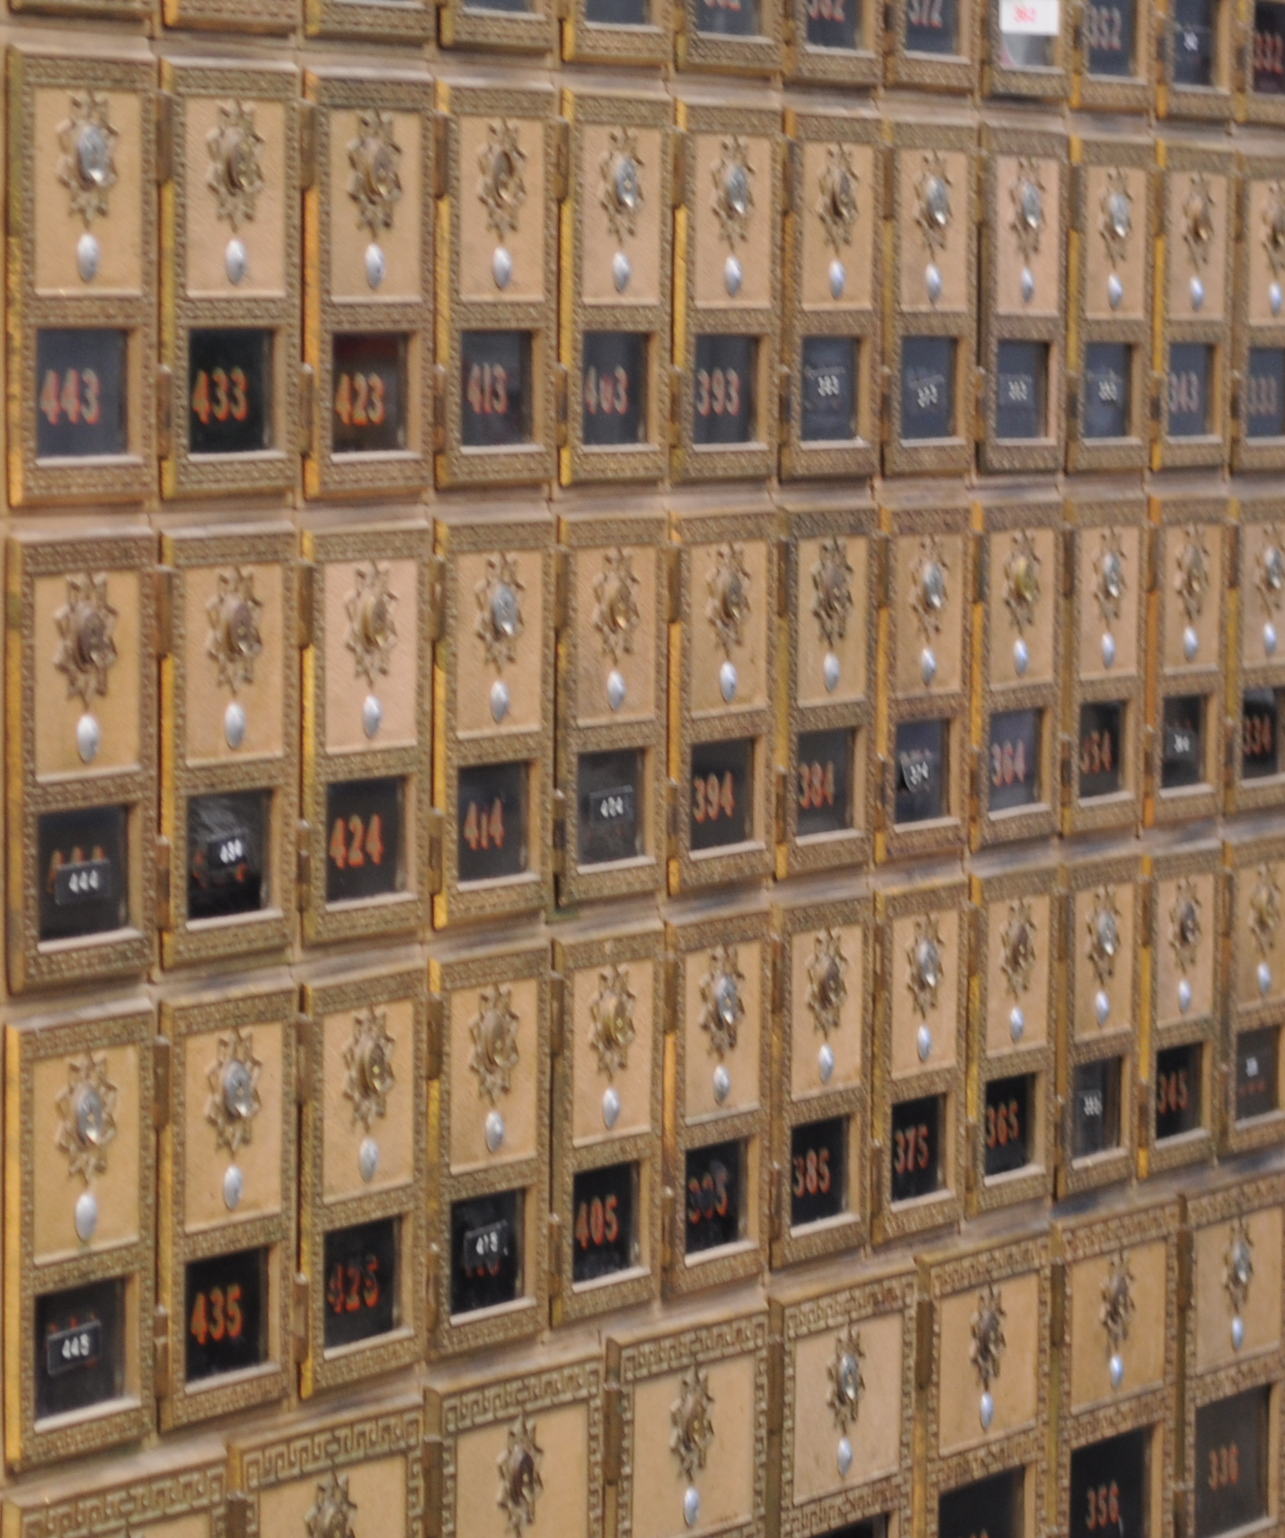
Sockets and Ports
A socket is a mailbox for datagrams
A port is the ID number of a socket
Notes:
A socket is just a mailbox for datagrams. There can be many apps running on a machine; sockets are the conceptual representation of the buffers and overhead that goes on behinds the scenes to manage them.
A port is like the ID of a mailbox. It’s used to uniquely identify a particular service on a machine. Generally speaking, only one app may receive packets from a particular port at a time.

Slide 16
Notes:
This is a different checksum. This checksum is for the UDP packet, and includes the addresses, the ports, the UDP header (light blue stuff, remember?) and the data payload itself. It gets calculated by the OS.

Slide 17
Notes:
And then of course your data.

Slide 18
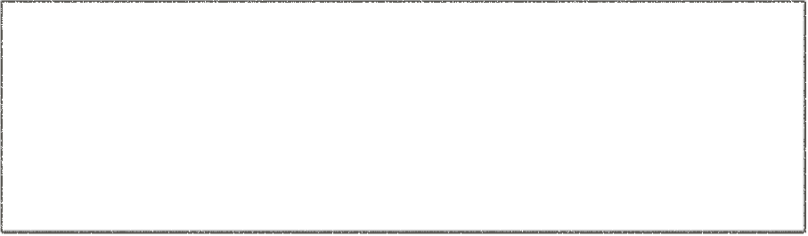

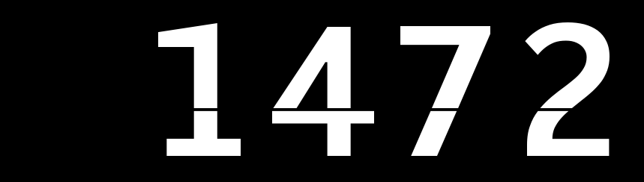
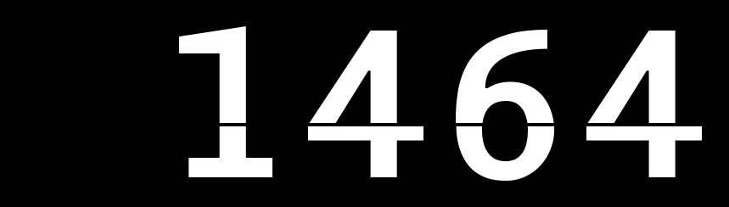

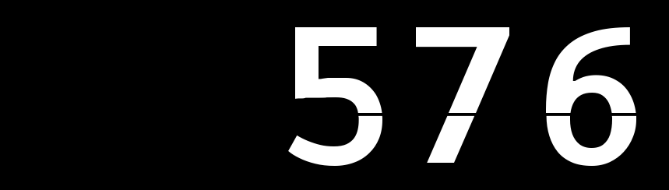
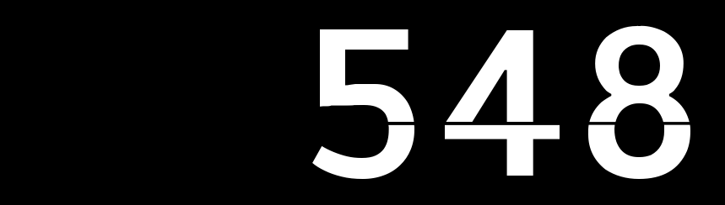
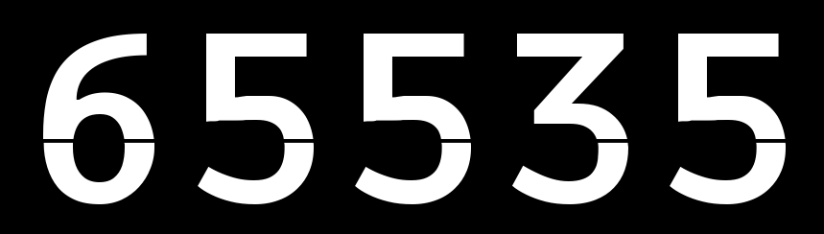
Maximum Packet Size?
Notes:
* How big can a UDP packet be? 65K
* No, not really. Ethernet MTU is 1500 bytes.
* No, not really. Overhead of 28 bytes means 1472.
* No, not really. MTU for a modem connection is 1492, -28 = 1464.
* No, not really. MTU for a 3G connection is 1428, -28 = 1400.
* Having fun yet?
* The Internet abstracts away network details, which is good (you don't have to worry about them, mostly) and bad (when you have to worry about them, you can't find them). There's a way to measure the MTU of a route, but--ha ha!--it uses ICMP, which most routers block because it's not secure. So, you're screwed.
* The MINIMUM MTU is 576. So use that, right?
No, not really. Header, remember? 548.

Slide 19
Safest Packet Size
Maximum Packet Size
Notes:
* And depending on what you're doing with those packets, having tiny ones might be really annoying.
* Also note that while they're *supposed* to tell you "hey, I'd have to fragment that, please break that packet up", what a lot of routers do with UDP packets too large is just throw them away... because hey, you knew it was unreliable when you wrote it.

Slide 20
UDP Packets
Completely self-contained
Minimal overhead
Unreliable
Sockets & Ports
1400 bytes should be safe, 548 bytes will be safe
Notes:
Completely self-contained
Minimal overhead
Unreliable
Sockets & Ports
1400 bytes should be safe, 548 bytes will be safe
[ACTIVITY: What are some things that can go wrong with datagrams? Well, what can go wrong with telegrams? garbled, missing, out of order, delayed, faked]

